Slide 1
Open source intelligence.
Twitter scraping using Twint
Enrique Bonsón
David Perea

Slide 2
Agenda
Open Source Intelligence (OSINT)
Open Source Tools (GITHUB)
Twint
Case study

Slide 3
Open Source Intelligence (OSINT)
Open source intelligence (OSINT) is the discipline that pertains to intelligence produced from publicly available information that is collected, exploited, and disseminated in a timely manner to an appropriate audience for the purpose of addressing a specific intelligence requirement.
OSINT is derived from the systematic collection, processing, and analysis of publicly available, relevant information in response to intelligence requirements.
U.S. Army (2010). FM 2-0 intelligence
Publicly available information on the Internet can be collected and processed with open source tools that can help gather the data from hundreds of sites in minutes and thus easing the collection phase.

Slide 4
Open Source Tools (GITHUB)
GitHub Inc. is a web-based hosting service for version control using Git. It is mostly used for computer code.
Git is version-control system for tracking changes in computer files and coordinating work on those files among multiple people.
GitHub make the relationships between users and between users and work artifacts transparent. This transparency enables developers to better use information such as technical value and social connections when making work decisions.
Tsay, J., Dabbish, L., Herbsleb, J., (2014). Influence of social and technical factors for evaluating contribution in GitHub. Proceedings of the 36th International Conference on Software Engineering

Slide 5
Open Source Tools (GITHUB)
Why GitHub?
96 million public repositories.
GitHub´s user create and maintain influential technologies alongside the world´s largest open source community.
31 million developers.
Developers use GitHub for personal projects, from experimenting with new programming languages to hosting their life´s work.
2,1 million business and organizations.
Business all sizes use GitHub to support their development process and to securely build software.
GitHub, (2018). Web site official. https://github.com/

Slide 6
Open Source Tools (GITHUB)
The importance of Github repositories is based on the social relationship between users and repositories. To identify useful software there are two elements in Github repositories: stars and forks .
Hu, Y., Zhang, J., Bai, X., Yu, S., Yang, Z., (2016) Influence analysis of Github repositories. SpringerPlus
“Fork” is producing a personal copy of someone else’s project. Forks act as a sort of bridge between the original repository and your personal copy. You can submit pull requests to help make other people’s projects better by offering your changes up to the original project. Forking is at the core of social coding at GitHub.
GitHub (2017). Forking Projects · GitHub Guides
"Star" on repositories to keep track of projects you find interesting and discover similar projects in your news feed.
GitHub (2018). About starts · GitHub Help

Slide 7
Twint -Twitter Intelligence Tool
Twint is an advanced Twitter scraping tool written in Python that allows for scraping Tweets from Twitter profiles without using Twitter's API.
Twint utilizes Twitter's search operators to let you scrape Tweets from specific users, scrape Tweets relating to certain topics, hashtags & trends, or sort out sensitive information from Tweets like e-mail and phone numbers.
Twint also makes special queries to Twitter allowing you to also scrape a Twitter user's followers, Tweets a user has liked, and who they follow.
Poldi, F., Zacharias, C., (2018). TWINT - Twitter Intelligence Tool. GitHub project

Slide 8
Twint -Twitter Intelligence Tool
Categories | Descriptions | Commands
General | Scrape all the Tweets from user's timeline. | twint -u [username]
 | Scrape all the Tweets from several user's timeline (max. 25 users) | twint -userlist [username],[username]
Word | Scrape all Tweets from the user's timeline containing a specific word. | twint -u [username] -s [word]
 | Collect every Tweet containing a specific word from everyone's Tweets. | twint -s [word]
 | Display Tweets by verified users that Tweeted about specific words. | twint -s [“words“] --verified
Date | Collect Tweets from the user's that were tweeted before year. | twint -u [username] --year [year]
 | Collect Tweets from the user's that were tweeted since date. | twint -u [username] --since [y-m-d]
File | Scrape Tweets from the user's and save to file.txt. | twint -u [username] -o [name file].txt
 | Scrape Tweets from the user's and save as a csv file. | twint -u [username] -o [name file].csv --csv
 | Scrape Tweets from the user's and save as a json file. | twint -u [username] -o [name file].json --json

Slide 9
Twint -Twitter Intelligence Tool
Categories | Descriptions | Commands
Audience | Scrape a Twitter user´s followers | twint -u [username] --followers
 | Scrape who a Twitter user follows | twint –u [username] --following
 | Collect all the Tweets a user has favorited | twint -u [username] –favorites
 | Collect full user information a person follows | twint -u [username] --following --user-full
Misc. | Show Tweets from the user's that might have phone numbers or email addresses. | twint -u [username] --email --phone
 | Scrape Tweets from the user's from a radius of kms around a place in location and export them to a csv file. | twint -g="longitude, latitude, number km" -o [name file].csv –csv
 | Use a slow, but effective method to gather Tweets from a user's profile (Gathers ~3200 Tweets, Including Retweets). | twint -u [username] --profile-full
 | Use a quick method to gather the last 900 Tweets (that includes retweets) from a user's profile. | twint -u [username] --retweets
 | Resume a search starting from the specified Tweet ID. | twint -u [username] --resume [Tweet ID]

Slide 10
A case study. Twitter in Andalusian municipalities
This study provides a general overview of the way local governments use Twitter as a communication tool to engage with their citizens.
A sample of the 29 most populated Andalusian local governments is examined.
The results show there is not a significant relationship between the population of a municipality and its Twitter activity, and there is a significant negative relationship between activity, audience and engagement.
The findings of the study also show that particular media and content types generate higher engagement.

Slide 11
A case study. Methodology (I)
Sampling
The tweets were scraped at the beginning of June 2018 using Twint. A total of 345,960 tweets were obtained, which were analyzed later.
They represented more than 85% of the total of tweets published by the studied municipalities since they joined Twitter until 31th May 2018.
The 15% not scraped are the retweets retweeted from the analyzed accounts. They can not be scraped because, for the time being, Twint is not able to scrape retweets.

Slide 12
A case study. Methodology (II)
Coding
The different content types that a tweet can contain and the operative categories for the content of the tweets were identified and defined.
The media type was identified according to the possible media that can be added in the tweets.
The identification of content type was based on the lists of local services prepared by Torres and Pina (2001) and later adapted by several authors (Bonsón et al., 2015; Martí et al., 2012). Even so, the list was further refined according to words included in the tweets provided by local governments.

Slide 13
A case study. Methodology (III)
Dictionary of content types
The tweets are classified into 7 types of categories. Two of these are Sport and Employment-Education.

Slide 14
Flowchart of scraping and content analysis
removePunctuation
removeNumbers
stopwords
TermDocumentMatrix
findFreqTerms
Twitter accounts
Twint scraping
CSV
Python
@Ayto_Sevilla
@malaga
@ayuncordoba_es
@...
twint --userlist Ayto_Sevilla,malaga,ayuncordoba - o ayto.csv - - csv
“tm” package
Refine categories
Define dictionaries
Classified
tweets
corpus
VectorSource
tm_map
stopwords
findFreqTerms
stripWhitespace
removePunctuation
removeNumbers
content_transformer
TermDocumentMatrix
R
Dictionary creation
“dplyr” package
grepl
filter

Slide 15
A case study. Results (I)

Slide 16
A case study. Results (II)

Slide 17
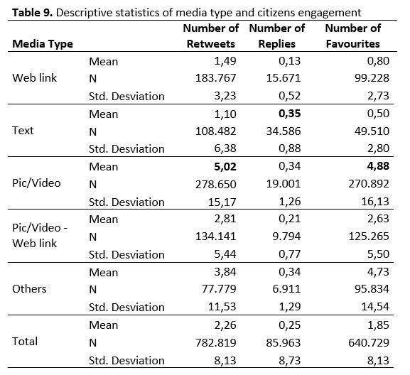
A case study. Results (III)

Slide 18
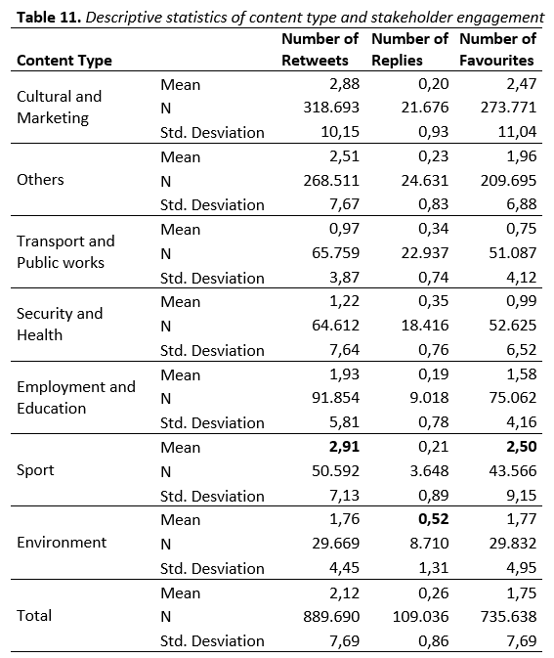
A case study. Results (IV)

Slide 19
A case study. Results (V)

Slide 20
A case study. Conclusions (I)
96.55% of the largest Andalusian municipalities have an official Twitter account.
The accounts differ in terms of their activity and audience.
The most common tweeted content appeared to be cultural and marketing content (26.37%).
Regarding media type, website links (35.68%) were the most frequently used,.
Citizens tend to choose retweets more often than favorites or replies to interact with the municipality.

Slide 21
A case study. Conclusions (II)
No significant relationship was found between municipality size and Twitter activity.
A significant negative relationship was found between Twitter activity (measured by the number of published tweets), the audience (measured by the number of followers), and the citizen engagement.
Photos and videos generate the highest rates of favorites and retweets.
The media type that generates the highest response rate was plain text.
Sport content generated the most retweets and favorites.
The content that tended to receive the most replies was related to environmental issues.

Slide 22
A case study. Future Research
The future studies could adopt our approach and apply it to a comparative context with other national and international regions, which could improve the generalizability and understanding of the results.
Conduct research exploring the reasons leading users to interact with municipalities’ Twitter pages.
Propose a Twitter commitment model for the municipalities to explain the relationship between the antecedent factors, the commitment that occurs, and the attitudinal and behavioral effects on the users.

